Slide 1


Department of Computer Science and Engineering
Air Quality Predication using ML
Karthik D 211419104122
Lalith Kishore L 211419104146
Maniyarasan M 211419104160
Mr. A. N. Sasikumar,
Assistant Professor
Dr. G. Senthil Kumar,
Professor

Slide 2
Introduction
Air pollution is a major issue affecting the health of people and the environment.
The quality of air is a significant factor that affects the quality of life.
Accurate prediction of air quality can help in taking proactive measures to prevent its harmful effects.
Machine Learning (ML) algorithms are powerful tools that can help in predicting air quality with high accuracy.
In this presentation, we will discuss the application of ML in air quality prediction and its benefits in improving the air quality.

Slide 3
Objective of the Project
Aim of the Project:
The aim of the air quality prediction using machine learning project is to provide accurate and reliable predictions of air quality levels in different regions. The project utilizes advanced machine learning algorithms to analyze historical data on air quality and predict future air quality levels. By accurately predicting air quality levels, the project aims to help individuals and authorities take preventive measures to reduce exposure to pollutants and improve public health.

Slide 4
Literature Survey
Year | Author | Title | Study
2021 | Shukla, S.V., Singh, S.K. | Air quality prediction using machine learning: A review | The review presents an overview of various machine learning techniques used for air quality prediction.
2020 | Sharma, N., Kumar, R. | Air pollution forecasting using machine learning algorithms: A review | The review evaluates different machine learning algorithms for air pollution forecasting.
2019 | Bhadauria, N., Jain, V., Jain, S. | Air pollution forecasting using machine learning algorithms: A case study of Delhi | The study presents a case study of Delhi, where machine learning algorithms are used to forecast air pollution levels.
2022 | Singh, N.P., Gupta, P. | A machine learning-based approach for air pollution forecasting | The study evaluates various machine learning algorithms for air pollution forecasting.
2019 | Wijaya, D.D., Aryal, B.N., Woo, J.K. | Machine learning for air quality predictions: A review | The review presents an overview of machine learning techniques used for air quality prediction.

Slide 5
Problem Statement
1. Despite numerous efforts to curb air pollution, many cities continue to experience poor air quality. This project aims to develop a machine learning model that can accurately predict air quality levels and provide insights for policymakers to take effective action.
2. Traditional methods for predicting air quality are often limited by the amount and quality of data available. This project aims to overcome those limitations by leveraging machine learning algorithms to make more accurate predictions.
3. Air quality can have a significant impact on public health, but predicting it accurately can be a challenging task. This project aims to develop a machine learning model that can predict air quality levels in real-time and help individuals make informed decisions about their health and well-being.
4. Air quality is influenced by a wide range of factors, including weather patterns, traffic, and industrial emissions. This project aims to develop a machine learning model that can effectively capture these factors and make accurate predictions about air quality levels.
5. With climate change and environmental degradation becoming increasingly pressing issues, predicting air quality levels is more important than ever. This project aims to leverage the power of machine learning to develop a scalable solution that can help cities and regions worldwide to monitor and improve air quality.

Slide 6
Proposed System
The proposed system for air quality prediction using random forest and decision tree algorithms has several advantages over existing systems, including Naive Bayes. Random forest and decision tree algorithms are both based on decision trees, which are a type of machine learning algorithm that models’ decisions and their possible consequences in a tree-like structure.
These algorithms are capable of handling both continuous and categorical variables, which makes them ideal for air quality prediction, where variables such as weather conditions and pollutant levels can be either continuous or categorical.
One significant advantage of using random forest and decision tree algorithms is their ability to handle complex relationships between variables.
The proposed system using random forest and decision tree algorithms has several advantages over existing systems, including their ability to handle complex relationships between variables, handle missing data effectively, enable feature selection, and provide insights into the factors that impact air quality.
These advantages make them an ideal choice for air quality prediction, and they have the potential to revolutionize air quality monitoring and control.

Slide 7
Software / Hardware used
HARDWARE REQUIREMENTS
Processor : Pentium Dual Core 2.00GHZ
Hard disk : 120 GB
RAM : 2GB (minimum)
SOFTWARE REQUIREMENTS
Operating system : Windows 7 (with service pack 1), 8, 8.1 and 10
Language : Python

Slide 8
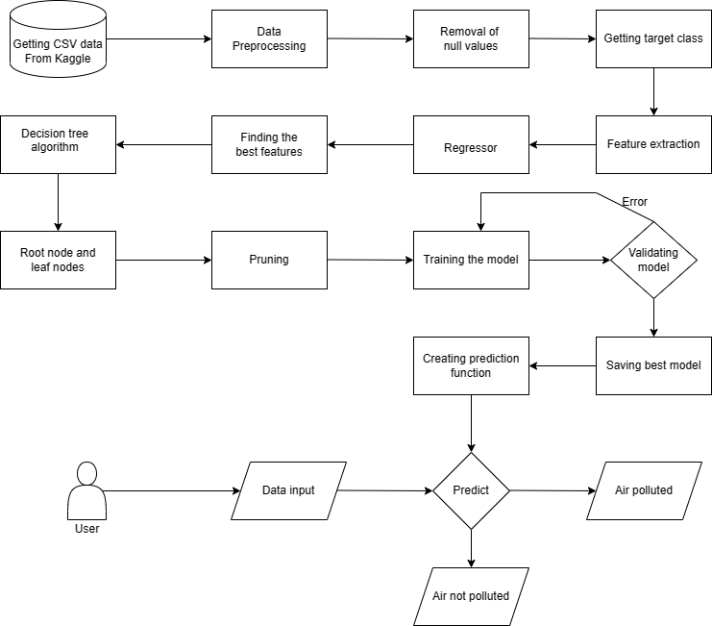
Architecture / Methodology used
System Architecture

Slide 9
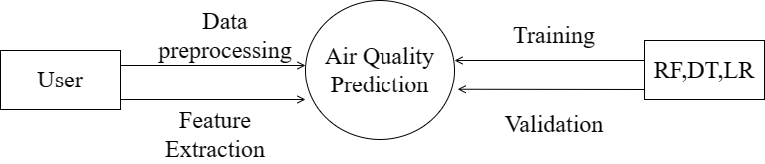
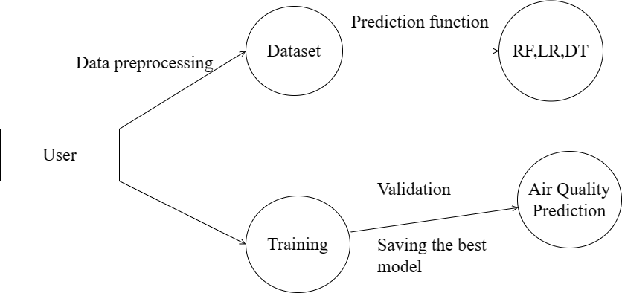
System Design - Flow Chart/DFD/ER
DFD Level 0
DFD Level 1

Slide 10
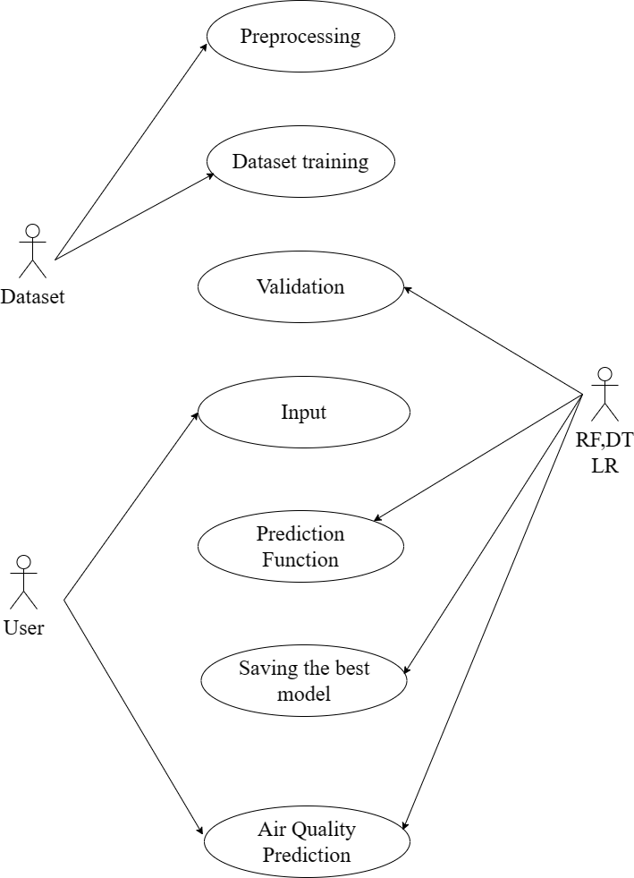
System Design - Flow Chart/DFD/ER
Use Case Diagram

Slide 11
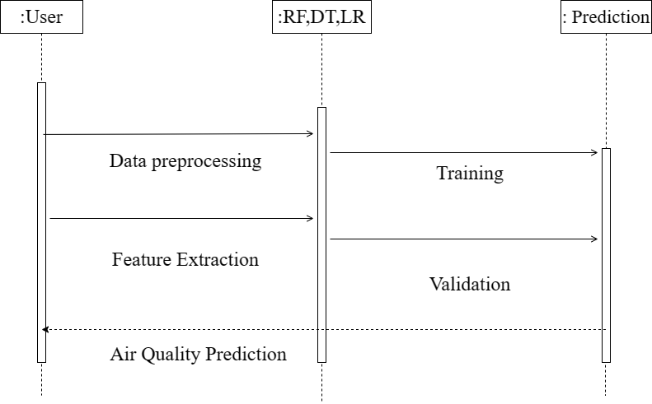
System Design - Flow Chart/DFD/ER
Sequence Diagram

Slide 12
Module Description
MODULE 1: DATA COLLECTION AND PREPROCESSING
Data Collection
The first step in data collection is to identify the sources of data. There are several sources of air quality data, including government agencies, private organizations, and research institutions. The most reliable source of air quality data is government agencies, which collect and report data regularly. These agencies use various types of instruments to measure the levels of air pollutants in the atmosphere.
Data Preprocessing
Data preprocessing is an important step in preparing the data for analysis. It involves transforming the raw data into a format that can be easily analyzed by machine learning algorithms. The following are the common steps in data preprocessing:

Slide 13
Module Description
MODULE 2: Model Training and Building
Logistic Regression
Logistic Regression is used to predict whether a given combination of environmental factors will result in good or poor air quality. The model is trained using the preprocessed dataset that was generated in Module 1. The training data is used to estimate the parameters of the model, which can then be used to predict the air quality index for new data points.
KNN Classifier
KNN is used to predict the AQI for a new combination of environmental factors by finding the K-Nearest Neighbors in the training set and determining the average AQI for those neighbors. The model is trained using the preprocessed dataset generated in Module 1. The training data is used to determine the optimal value of k and to calculate the distances between the data points.

Slide 14
Module Description
Decision Tree Classifier
Decision Tree can be used to predict the AQI for a new combination of environmental factors based on a set of decision rules. The model is trained using the preprocessed dataset generated in Module 1. The training data is used to construct the decision tree based on the features and the AQI values.
Random Forest Classifier
Random Forest is used to predict the AQI for a new combination of environmental factors by combining the predictions of multiple decision trees. The model is trained using the preprocessed dataset generated in Module 1. The training data is used to construct multiple decision trees using different subsets of the features and the data points.
Model Evaluation
Once the models are trained, the next step is to evaluate their performance. In air quality prediction, model evaluation involves comparing the predicted AQI values to the actual AQI values in the testing set.

Slide 15
Module Description
MODULE 3: PREDICTION
Module 3 is the final step in the air quality prediction process, which involves using the best-performing model to predict the AQI for new data points. The process of making predictions begins with collecting new data on the environmental factors that affect air quality. Once the new data has been collected, it is preprocessed using the same preprocessing steps used in Module 1. This includes data cleaning, feature selection, feature scaling, data splitting, and data encoding to ensure that the new data is suitable for machine learning analysis.
In conclusion, Module 3 is a critical step in the air quality prediction process as it involves using the best-performing model to make accurate predictions about air quality for new data points. By integrating the model into a web application or other platform, the predictions can be made in real-time, allowing users to make informed decisions about their activities and health. To ensure the accuracy and effectiveness of the model, it is important to continuously monitor and update it with the latest data and performance metrics.

Slide 16
Testing /Performance Evaluation / Results
Unit Testing
The term "unit testing" refers to a specific kind of software testing in which discrete elements of a program are investigated. The purpose of this testing is to ensure that the software operates as expected.
Integration Testing
The programme is put through its paces in its final form, once all its parts have been combined, during the integration testing phase. At this phase, we look for places where interactions between components might cause problems.

Slide 17
Testing /Performance Evaluation / Results
Functional Testing
One kind of software testing is called functional testing, and it involves comparing the system to the functional requirements and specifications. In order to test functions, their input must first be provided, and then the output must be examined. Functional testing verifies that an application successfully satisfies all of its requirements in the correct manner. This particular kind of testing is not concerned with the manner in which processing takes place; rather, it focuses on the outcomes of processing. Therefore, it endeavors to carry out the test cases, compare the outcomes, and validate the correctness of the results.

Slide 18
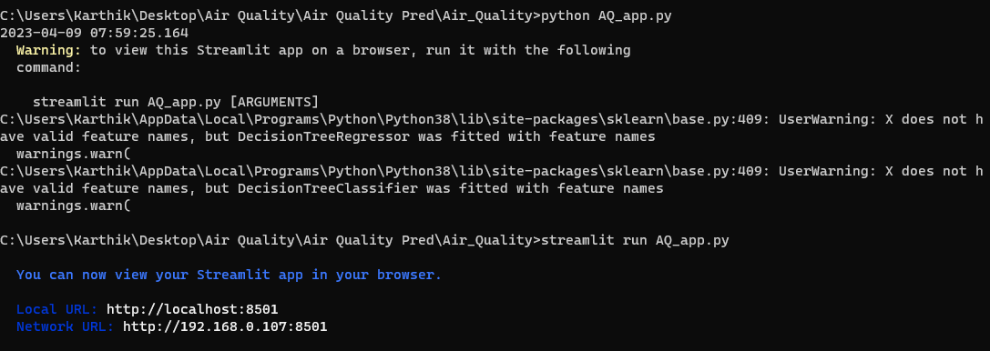
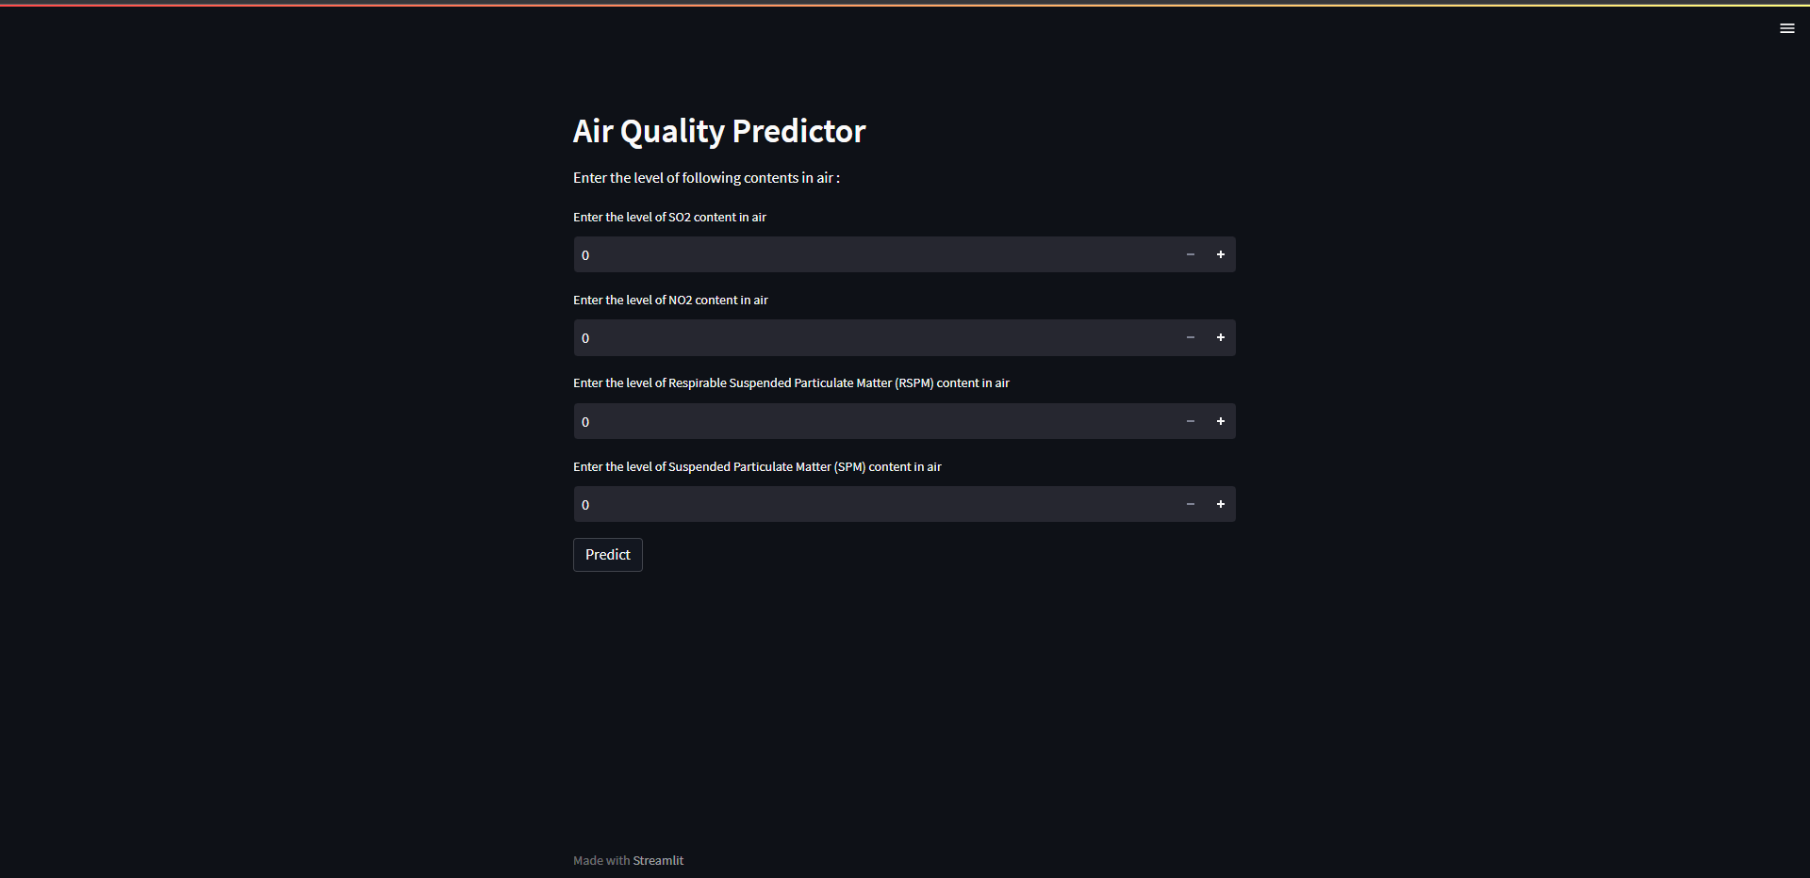
Screen Shots
Deploy environment
Home Page

Slide 19
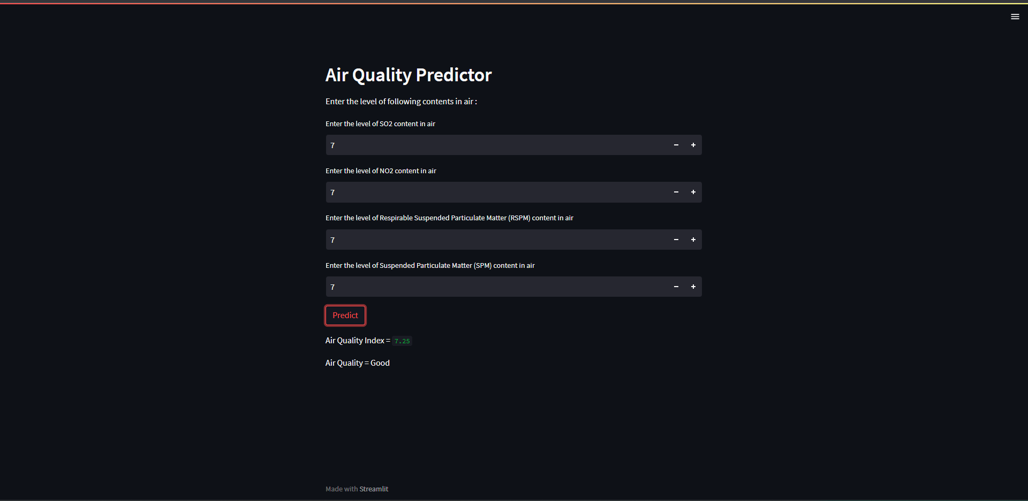
Screen Shots
Sample Screen of the Prediction Model

Slide 20
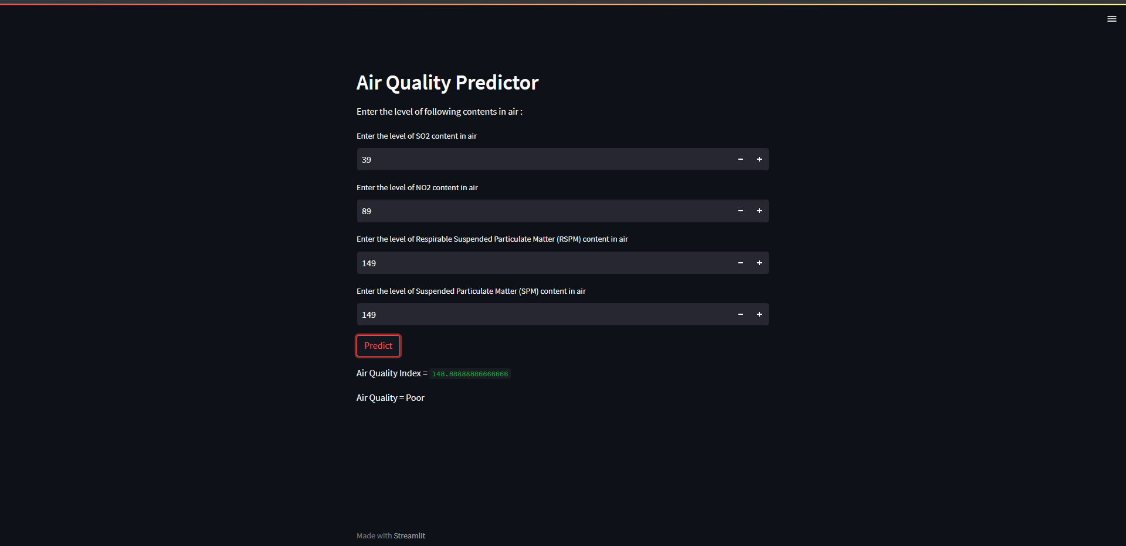
Screen Shots
Sample Screen of the Prediction Model

Slide 21
Conclusion / Feature Enhancement
In conclusion, air quality prediction using machine learning has shown potential for accurately predicting air pollution concentrations. However, the performance of these models is highly dependent on the quality and quantity of the input data, and the interpretability of these models remains a challenge. Therefore, further research is needed to enhance the accuracy and interpretability of machine learning models for air quality prediction. Future research could focus on improving the quality and quantity of input data used for air quality prediction. This could involve incorporating more sources of data, such as satellite imagery or data from low-cost air quality sensors. Additionally, research could focus on developing methods to account for uncertainty in input data, which could improve the accuracy of machine learning models. Another important area for future research is improving the interpretability of machine learning models. This could involve developing methods for explaining the predictions made by machine learning models, such as feature importance analysis or local interpretability methods.

Slide 22
Reference Paper/ URL
[1] Temesegan Walelign Ayele, Rutvik Mehta, “Air pollution monitoring and prediction using IoT”, Second International Conference on Inventive Communication and Computational Technologies (ICICCT), 2018
[2] Saba Ameer, Munam Ali Shah, Abid Khan, Houbing Song, Carsten Maple, Saif Ul Islam, Muhammad Nabeel Asghar, “Comparative Analysis of Machine Learning Techniques for Predicting Air Quality in Smart Cities”, IEEE Access (Volume: 7), 2019
[3] Yi-Ting Tsai, Yu-Ren Zeng, Yue-Shan Chang, “Air Pollution Forecasting Using RNN with LSTM”, IEEE 16th Intl Conf on Dependable, Autonomic and Secure Computing, 16th Intl Conf on Pervasive Intelligence and Computing, 4th Intl Conf on Big Data Intelligence and Computing and Cyber Science and Technology Congress, 2018
[4] Venkat Rao Pasupuleti, Uhasri, Pavan Kalyan, Srikanth, Hari Kiran Reddy, “Air Quality Prediction Of Data Log By Machine Learning”, 6th International Conference on Advanced Computing and Communication Systems (ICACCS), 2020
[5] Shengdong Du, Tianrui Li, Yan Yang, Shi-Jinn Horng, “Deep Air Quality Forecasting Using Hybrid Deep Learning Framework”, Transactions on Knowledge and Data Engineering (Volume: 33, Issue: 6), 2021

